Slide 1

Metholodogy for Creating Custom Wiki base
Aninda Maulik
Mohamadnour Badr
Morad Benkaraache
Dhayananth Dharmalingam

Slide 2
Abstract
This Project is to provide a methodology for a community that in order to create custom Wikibase for their documentation.
Tasks with detailed Steps that each community should follow in order to successfully create custom Wiki-base
Wikibase is a free RDF data source that can be edited, published and used by both human and automated bots.
This data source approach has been followed in Semantic web technology.
We will demonstrate our methodology with “Nature Disaster” as our topic for this demonstration purpose.

Slide 3
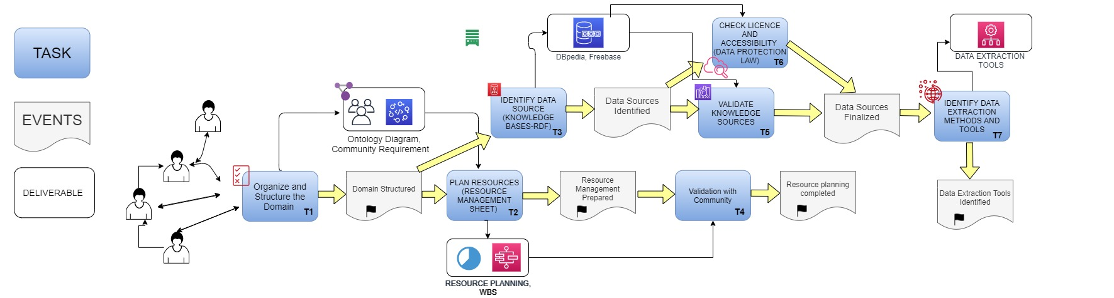
Methodology
T7
T7
T1
T2
T3
T5
T7
T7
T7
T4
T6
T8
T7
T7
T7
T7
T7
T7
Phase 1
T7
T7
Click

Slide 4
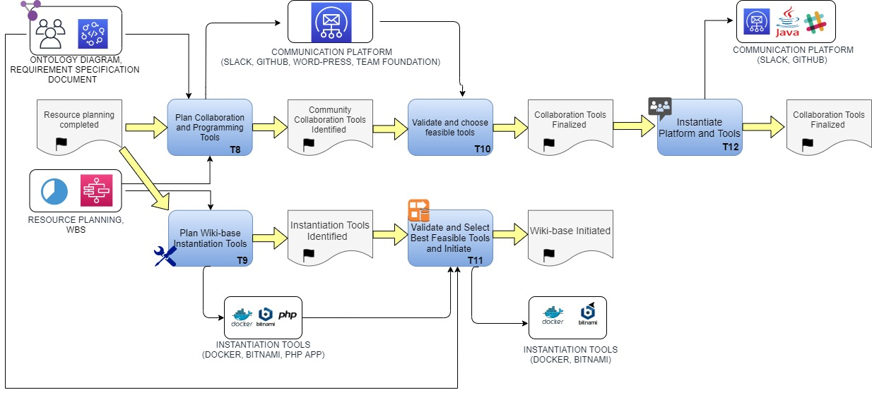
Methodology
T7
T7
T1
T2
T3
T5
T7
T7
T7
T4
T6
T8
T7
T7
T7
T7
T7
T7
Phase 2
T7
T7
Click

Slide 5
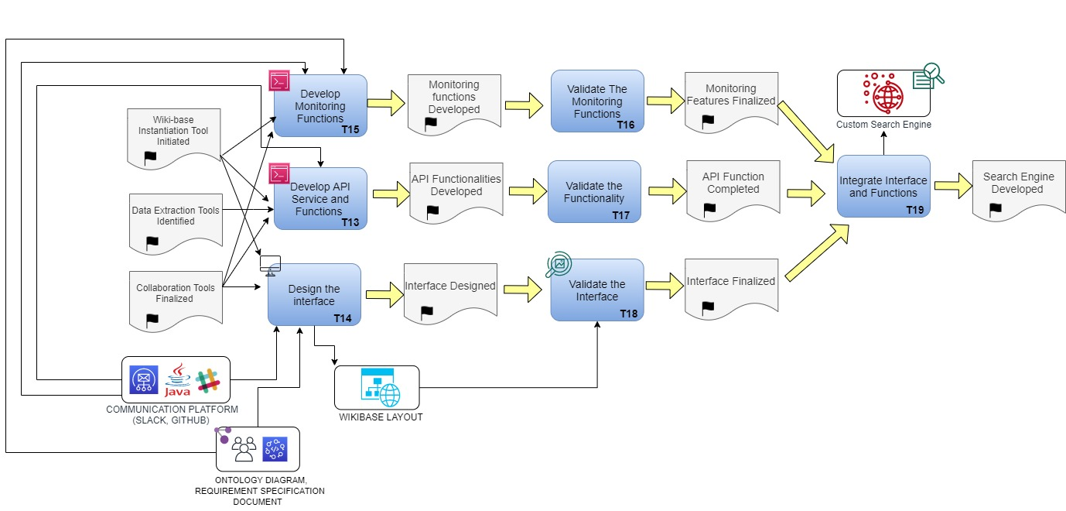
Methodology
T7
T7
T1
T2
T3
T5
T7
T7
T7
T4
T6
T8
T7
T7
T7
T7
T7
T7
Phase 3
T7
T7
Click

Slide 6
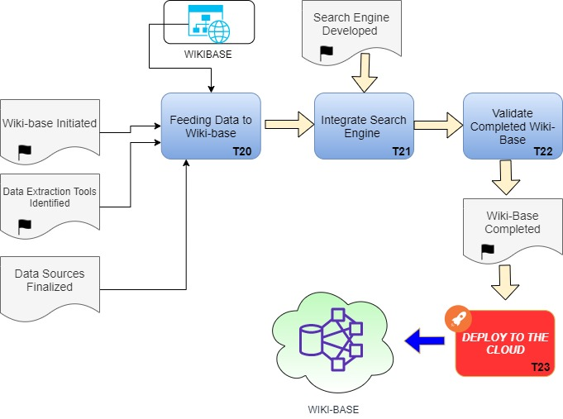
Methodology
T7
T7
T1
T2
T3
T5
T7
T7
T7
T4
T6
T8
T7
T7
T7
T7
T7
T7
Phase 1
T7
T7
Click

Slide 7
Organize and structure the domain
Identify the domain
Research on domain
Consult expert for the gain better understanding and knowledge of the domain (Ex: technical knowledge)
Identify the entitles
Identify the properties
Represent relations between entities and properties

Slide 8
Key of the Onotologie :
The entity represents the various components of the domain, for example: in case of natural disasters can find the entity Type Disaster (Disaster), or Evaluation of the disaster (Evaluation), Expert, and Area ...
Entity
Attribute
/property
The attribute defined better the entity, by defining it is different components if makes the case of the Disaster entity, finds (the name, Causes, Degree of Disaster ...)
The relation represents the action that one can generate through two entities, it defines the action in order to understand well the relation between two entities
example: the action (Evaluate by) which writes the relation between the measure of the danger of the Disaster and the experts who assess it ... Basically this relations facilitates the understanding of the ontology and yhe relation between their differents entities.
Relation

Slide 9
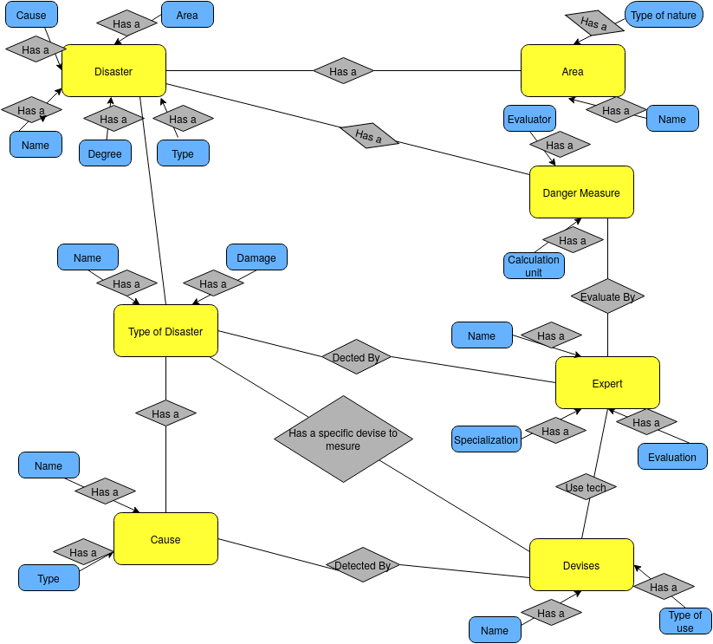

Slide 10
Steps to generate an Otologie :
Pre-step + 2 Steps
The 2 steps :
Entity
1/ How identify the Entities of The Ontologies
So to do achieve this first Step you have to :
- Know and master the terminologies and the different components of the field. (As in the case of our subject (Natural Disasters) we find: The disaster, the causes, the Type of disasters, the experts who analyze and assess it is disasters, the currencies that is used ...).
While documenting your self and using data sources as noted on the pre-step.

Slide 11
Steps to generate an Otologie :
Pre-step + 2 Steps
The 2 steps :
Attribute
/property
2/ How to identify the Relation , attribute/property of The Ontologies :
So to do achieve this Step you have to :
- First of all, to succeed in this step you have to carry out the previous step, because you just have to understand the components and terminologies of the domain in order to generate the details for each
entity. (for example: if we consider the Disaster entity, we know when we will have as properties: Name, Type, Cause, area, Degree, experts ...).

Slide 12
Steps to generate an Otologie :
Pre-step + 2 Steps
Relation
The 2 steps :
2/ How to identify the Relation , attribute/property of The Ontologies :(continuation)
We can identify certain relation between it is entities like for example: the relation "Detected By" which connects the entity "Cause" and "Detect" and that, that means: the causes of a catastrophe are detectable Or identify the relationship of "Use Tech" between the entities "Expert" and "Currency", which means experts can use technologies that consist of "Currency" to understand the causes of certain disasters.

Slide 13
Resource management
Identify the required resource for the project.
Identify task, difficulties and workload.
Define the community organization structure.
Flat, Tree organization structure etc
Define duties and roles of each member.
Estimate the duration.
Output- Resource management sheet, WBS.
Define meeting, discussion point and dates.

Slide 14
Plan Collaboration Platform
Planning and initiating collaboration tools are mandatory objective on every community based projects.
That helps to collaborate, coordinate and organize their work in most sufficient manner.
Steps
Define communication standard
Define sub community – if necessary
Define communication and collaboration tools
Google slides, Google doc, Git-hub, Slack, Skype, Team Viewer
Check the community requirement and flexibility of the selected tool
Initiate collaboration tools

Slide 15
Some of the examples
Communication tools :
Skype, Slack, Team Viewer, WhatsApp, Facebook group.
Code collaboration and versioning tools (Version Control Tools)
Github, Gitlab, Bitbucket, Mercurial, SVN
Remote Desktop Control
Team viewer, Join me, Remote Desktop (MS).

Slide 16
Wiki-Base instantiation
This is most crucial task in this methodology.
This task provides supportive steps and tools that a community can follow in order to instantiate Wikibase instance.
There are many tools found in the internet in order to create an instance of the Wikibase. Community members should select feasible and appropriate tool for their project based on the community requirement.
We have listed most famous and standard tools in this section.
Docker – A self hosted container with millions of images. We can simply pull and run any image for free in this container.
Manual installation (Tutorial)- Wikimedia gives open source PHP application that can be downloaded directly to the local machine and can be executed or hosted in local server(XAMPP) for the purpose of custom Wikibase instantiation.
Tikiwiki – This tool provides complete platform with integration of designing tools where user can able to design and publish their custom RDF Data source without needing of deep programming skills. Note: This tool does not providing Wikibase instance.
Bitnami – This tool also hosted with hundreds of images. Wikibase image also hosted in this web application and can be reused for any community purpose
Digital Ocean – This tools helps to publish the Custom wikibase in the internet

Slide 17
Docker Initiation steps
Download and Install - Docker.
Download the docker-compose.yml file example(save it into your working directory with the name docker-compose.yml).
Downloading images and starting the containers.
Work as containers
Docker file(5-30 line)
Create images.(run in the container),it will include the node.js ,project code and installation of programs.
By the image name we can run it in any machine.

Slide 18
Functionality on our wiki
We will demonstrate our Wikibase instance .
Features can be reused by any community members like add some page , organizing the pages , import different types of data and many other features.
We haven't imitated complete features of the Wiki. We will only demonstrate suitable part which are necessary for our chosen domain and project.

Slide 19
Start with some basics
From your localhost path –phpmyAdmine check you create phpmyAdmine Data Base .
Install Media-Wiki by https://192.168.1.98/wiki/mw-config/ for calling the Data Base.
Install all needed extensions and add them on the localhost.php file

Slide 20
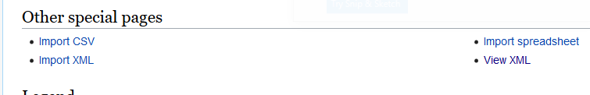
Work with extensions
Extension page allows to install various extensions to extend your local wiki functionalities and features.
Import xml , csv , file to the wiki or to see our pages by xml format
Special Pages → Other special pages.
Ex: www.yourDomain.com/SpecialPage:ImportCSV

Slide 21
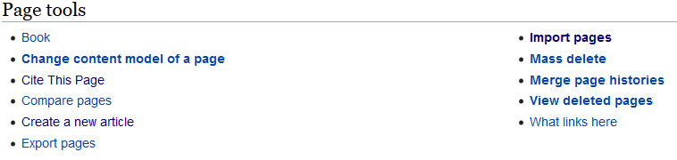
Import pages and category from wikis site
From the wikidata → Special pages → Export pages → then search for what you want .(should be xml format)
From your wiki Special pages → Import pages.

Slide 22
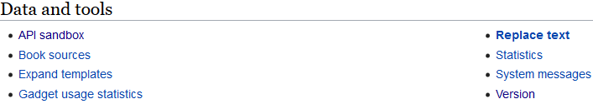
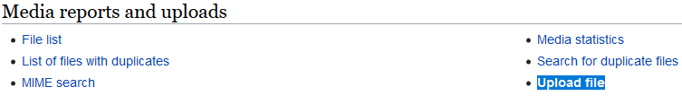
Uploading files& Check changes
Check all the new changes .
Special pages → Data and tools
→ Version.
Uploading files and images.
Special pages → Media reports and uploads→ Upload file.

Slide 23



Identify the data sources
Wiki base can be a collection of many data sources
A wiki base community can work together to import data into their wiki base from different bases
Identify available data sources (RDF – Data sources)
Wikipedia, Wikidata, WikiMedia, DBPedia (https://wiki.dbpedia.org/), Amazon Neptune
Check data availability
Select Data sources by considering community requirement and domain
Validate the data sources with community members
Identify required data set from those selected data source and check data accessible privilege (Data protection act, Patent rights)

Slide 24
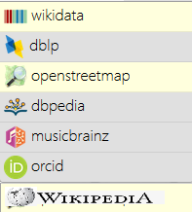
Identifying data sources
Task
Querying data from the identified data sources
1.SparQL method
2. Automatic Bots
3. Python Bots
4. Java Bots
5. Self Created Bots
6. Api Techniques
Types of data sources
Why identify?
Wikibase
Un-Structured
Structured
Our Choice: Sparql Technique
Structured
RDF data
Semi-structured
1.Wikidata
2.Wikipedia3.DBpedia
RDF data sources
Triplets
1.Subject
2.Predicate3.Object
Tiger(Subject) is(Predicate) ferocious(Object)
Ferocious(Subject) is a quality of (Predicate) carnivores(Object)

Slide 25
Dataset Import
Users can able to import dataset from external sources into wikidata.
The required data for a wikibase can be important using existing data importing tool in wikidata by specifying external link, name and the description of the dataset.
The imported data can be used by other people too.
The documenting and import process page enables platform to the community to collaborate and provides a record for updating, correcting errors and keeping track of updated datasets.

Slide 26
Bot request
Bots can be created to extract data from different data sources to the wiki data.
There are some bot policies and constrains were there. Initially a bot request made to the Wikidata community to test the legitimacy of the bot. and then the tasks of the bot can be accepted or rejected.
The bots can be also created to create a new entity, alter and delete the entity when it identified that it was incorrectly created by bot.
PetScan- for creating items from Wikimedia pages and/or adding same statements to items
QuickStatements- for creating items and/or adding different statements to items
OpenRefine - to import any type of data from tabular sources
API Import
Directly import RDF data using API end point to the local wiki.

Slide 27
Sparql techniques to query data from data-sources like wikidata and wikipedia
#wikidata
#Map of places which got hit my natural disaster
#added 2017-08
#defaultView:Map
SELECT
* WHERE {
?item wdt:P31/wdt:P279* wd:Q8065;
wdt:P625 ?geo .
}
#wikipedia
SELECT ?country ?countryLabel ?article WHERE {
?country wdt:P31/wdt:P279* wd:Q8065.
?article schema:about ?country .
?article schema:isPartOf <https://en.wikipedia.org/>.
SERVICE wikibase:label {
bd:serviceParam wikibase:language "en"
}
}

Slide 28
Sparql techniques to query data from data-sources like DBpedia
# dbpedia
PREFIX vrank:<http://purl.org/voc/vrank#>
SELECT DISTINCT ?uni ?uniLabel ?pr WHERE {
?uni wdt:P31/wdt:P279* wd:Q8065.
SERVICE <http://dbpedia.org/sparql> {
?uni vrank:hasRank/vrank:rankValue ?pr
}
SERVICE wikibase:label {
bd:serviceParam wikibase:language "[AUTO_LANGUAGE],en".
}
} ORDER BY DESC(?pr) LIMIT 50

Slide 29
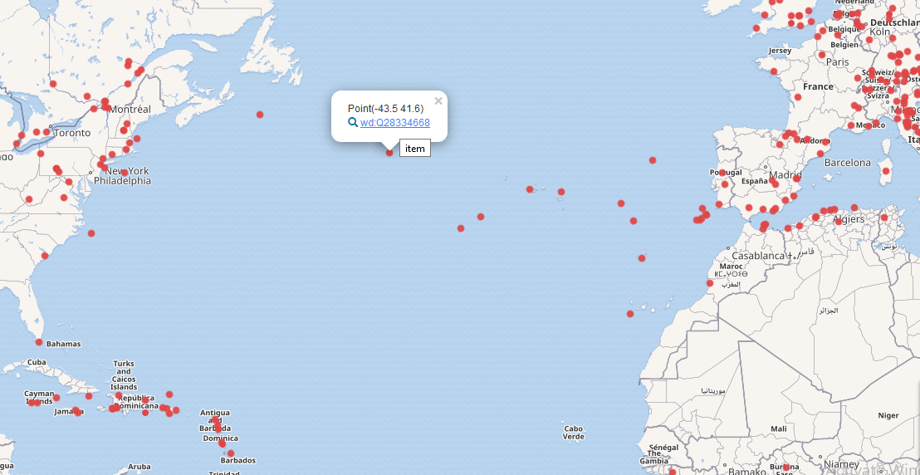
Query Result from (S-Sparql, P-Protocol,A-And,R-RDF,Q-Query,L-Language
#Map of places which got hit my natural disaster
#added 2017-08
#defaultView:Map
SELECT
* WHERE {
?item wdt:P31/wdt:P279* wd:Q8065;
wdt:P625 ?geo .
}

Slide 30
Customized Search Engine
Search engine will helps to query custom wiki base
Users can able to query custom wikibase without any prior technical knowledge and skills
Ex: Sparql, API Endpoint
Helps to visual and search data with more organized and convenient way.
Can reuse existing search engine
Ex: Qanswer-API Reference: http://qanswer-core1.univ-st-etienne.fr/swagger-ui.html
Can hire experts to develop custom search engine
Steps:
Identify querying techniques
Refer to the API document
Check existing application and examples
Hire experts to do the job.
Reuse libraries – Java-Media-Kit, Python-API-Kit by MediaWiki

Slide 31
Create Custom Search Engine
Steps:
Define the search engine requirement by considering the domain and community requirement.
Examine the expected features with community
Ex: Search index, Autosuggest, Filtering options
Decide the architecture with Community
Validate developed application with community members to assure the features

Slide 32
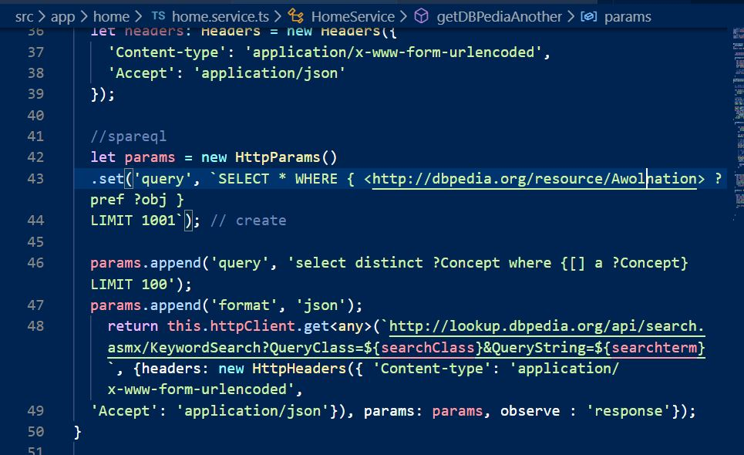
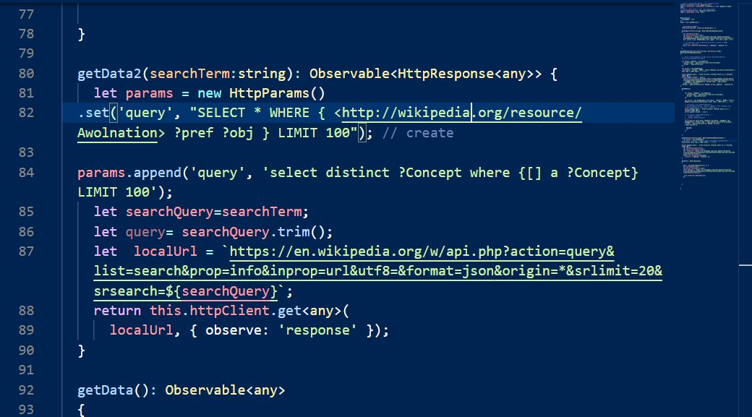
API Query : Spareql
DBPedia API Query
Wiki-data API Query

Slide 33
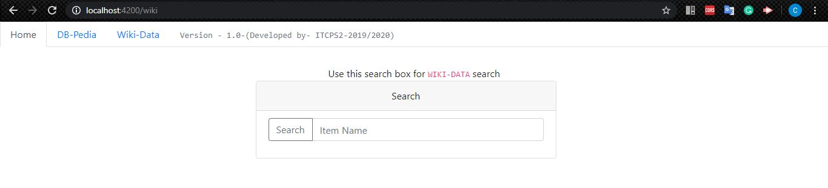
Search Engine

Slide 34
Background Monitoring System
Helps community to improve the Wikibase in future.
Helps to identify user interest and need.
Improve the search results.
Improve the customer base with quality search result.
Helps to analyse and understand current user interest and information need
Increase the information availability.
Community members can able to keep work based on user interest to provide more information that satisfy current user searches.

Slide 35
Background Monitoring System
Steps:
Implement search result feed back system.
Ex: Is this answer helpful,
Create rating system for query result.
Ex: Rate this answer
Identify session time of each user.
If user frequently searches with different keyword, then he is not getting relevant answer what he searching for.
That helps to feed wikibase with missing information.
Timely check searching query parameters of custom Wiki-base to understand current user interest.
So, the community can work in future to provide more convenient information for current user interest.
Implement a feedback section in the search engine.
Users can provide their feedback regarding improvements and answer quality.
Perform yearly or timely survey among user base to identify the limitation of current wikibase and to improve it for better results.

Slide 36
Background Monitoring System
Based on the result of background monitoring task, community members can re-iterate necessary steps in the methodology.
Identifying Data sources for current user interest.
Identifying data extraction tools for selected data sources.
Extract data to the custom wiki base
Create new data which is not available in the online knowledge sources
Improve the search engine functionalities with more features like filters and auto suggestions.

Slide 37
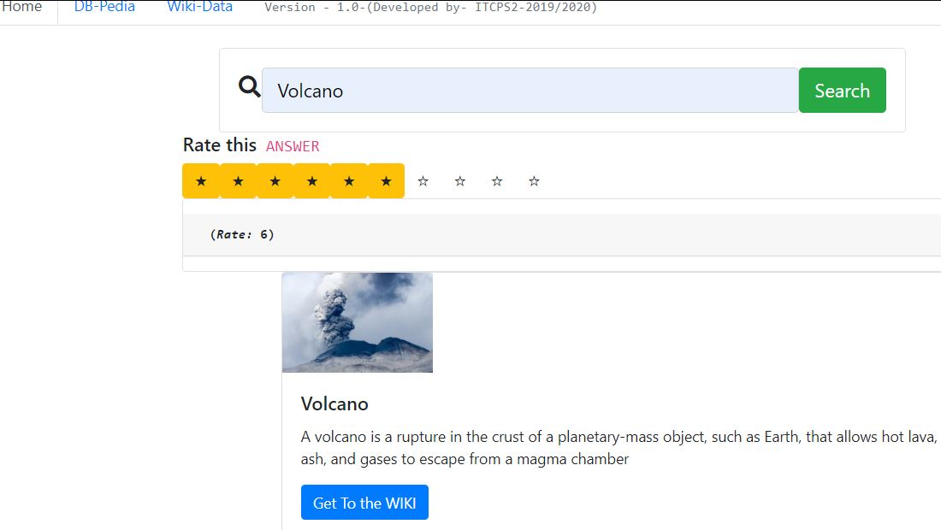
Background monitoring System
Store user centric data
Ex: User feedback, User rating on results, User session time, Current interest of user etc.
Analyse the data for finding patterns and relations
Work continuously to deliver better user experience and to improve the service of Wiki base

Slide 38
Thank you Questions ?

